Slide 1
Introduction to deep learning
Ali Madani
Farnoosh Khodakarami

Slide 2
Introduction to neural network modeling

Slide 3
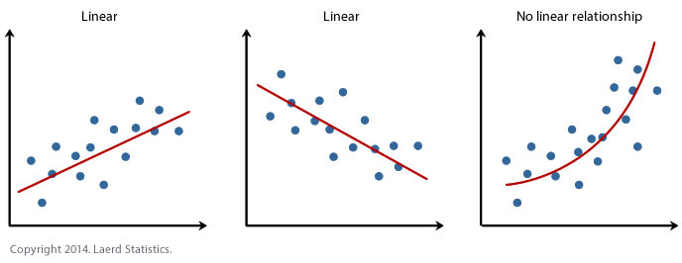
How could we automate identification of type of relationship between output and input ?
Linear relationship
Nonlinear relationship

Slide 4
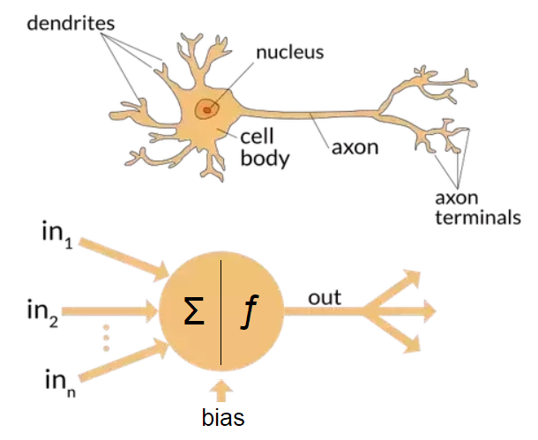
Biological inspiration for artificial neural networks
Flow of biological signal
https://towardsdatascience.com/

Slide 5
Biological inspiration for artificial neural networks
https://towardsdatascience.com/

Slide 6
Supervised learning using
fully connected layers

Slide 7
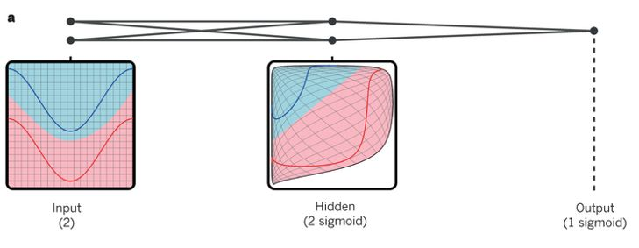
Distort the input space to make the classes of data linearly separable
LeCun, Yann, Yoshua Bengio, and Geoffrey Hinton. "Deep learning." nature 521.7553 (2015): 436.

Slide 8
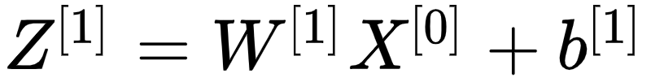
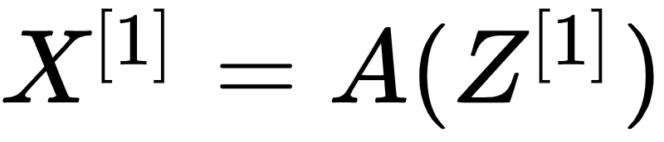
Mathematics of forward propagation in more details
Input layer
Hidden layer 1
Hidden layer 2
Output layer

Slide 9
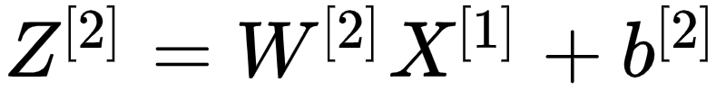
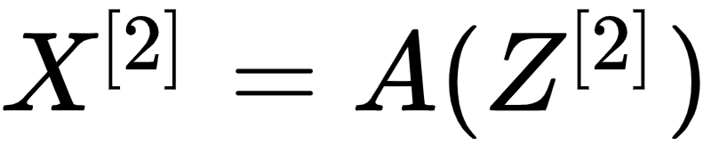
Mathematics of forward propagation in more details
Input layer
Hidden layer 1
Hidden layer 2
Output layer

Slide 10
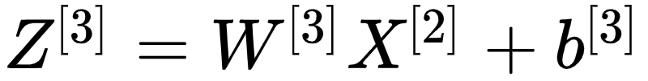
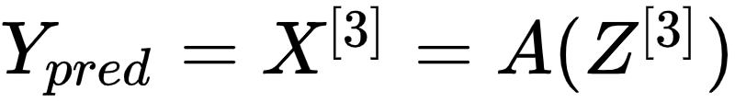
Mathematics of forward propagation in more details
Input layer
Hidden layer 1
Hidden layer 2
Output layer

Slide 11
Mathematics of backward propagation in more details
Input layer
Hidden layer 1
Hidden layer 2
Output layer

Slide 12
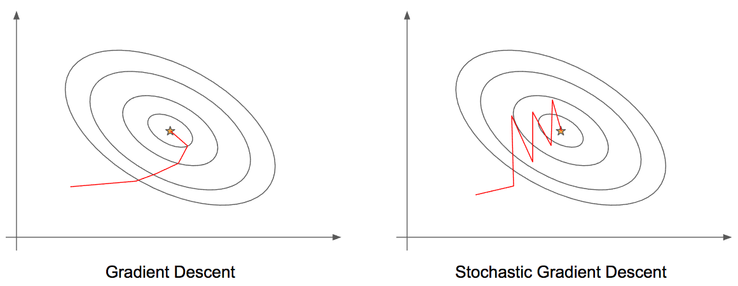
Optimization in neural network
?

Slide 13
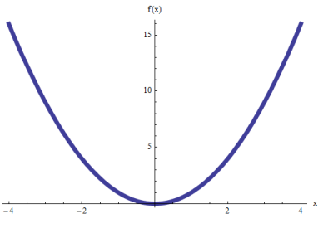
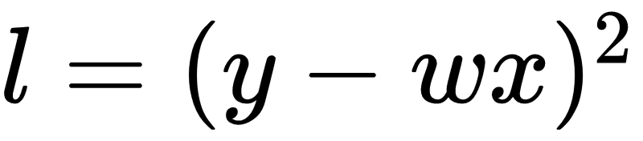
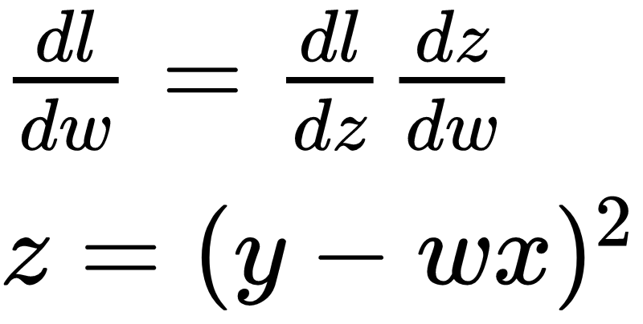
Finding minimum point in parabolic functions

Slide 14
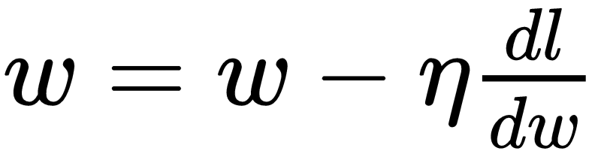
Finding minimum point in parabolic functions

Slide 15
Optimization via (stochastic) gradient descent
Batch versus mini-batch gradient descent
Stochastic gradient descent
Optimization algorithms
Adagrad
Adadelta
RMSprop
Adam
AMSGrad

Slide 16


gradient descent
Obtaining the parameters in the direction of maximum variation:
Cost function
Learning rate
Issue: slow and interactable for large datasets as the gradient is calculated for all the data points

Slide 17
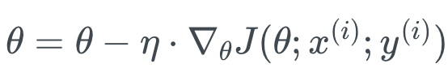
Stochastic gradient descent
Obtaining the parameters in the direction of maximum variation:
Cost function
Learning rate
Issue solved: parameter update for each training example
Objective function fluctuates
Maybe get to a better local minima faster (by jumps)

Slide 18
Comparison of gradient descent and stochastic gradient descent

Slide 19
Mini-batch gradient descent
Let’s get the middle
Cost function
Learning rate
Update for mini-batches of n training examples

Slide 20
Mathematics of backward propagation in more details
Input layer
Hidden layer 1
Hidden layer 2
Output layer

Slide 21
What changes in forward and backward propagations
Representation values
Representation values
Output
Input layer
Hidden layer 1
Hidden layer 2
Output layer
Weights
Weights
Weights

Slide 22
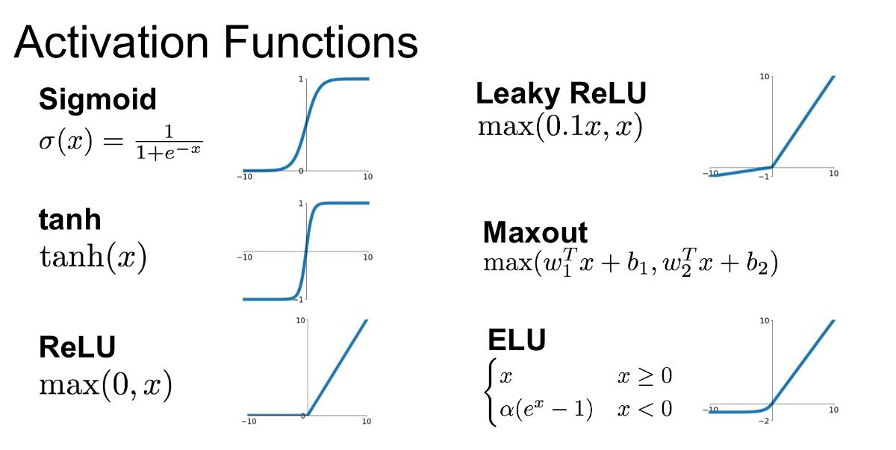
Adding nonlinearity via activation functions

Slide 23
Convolutional neural networks

Slide 24
Convolutional Neural Network (CNN)
Convolutional layers
Specify filters in the images
Detect Pattern in Images
shape, object, corners, circles
Deeper layers can detect more complex objects

Slide 25
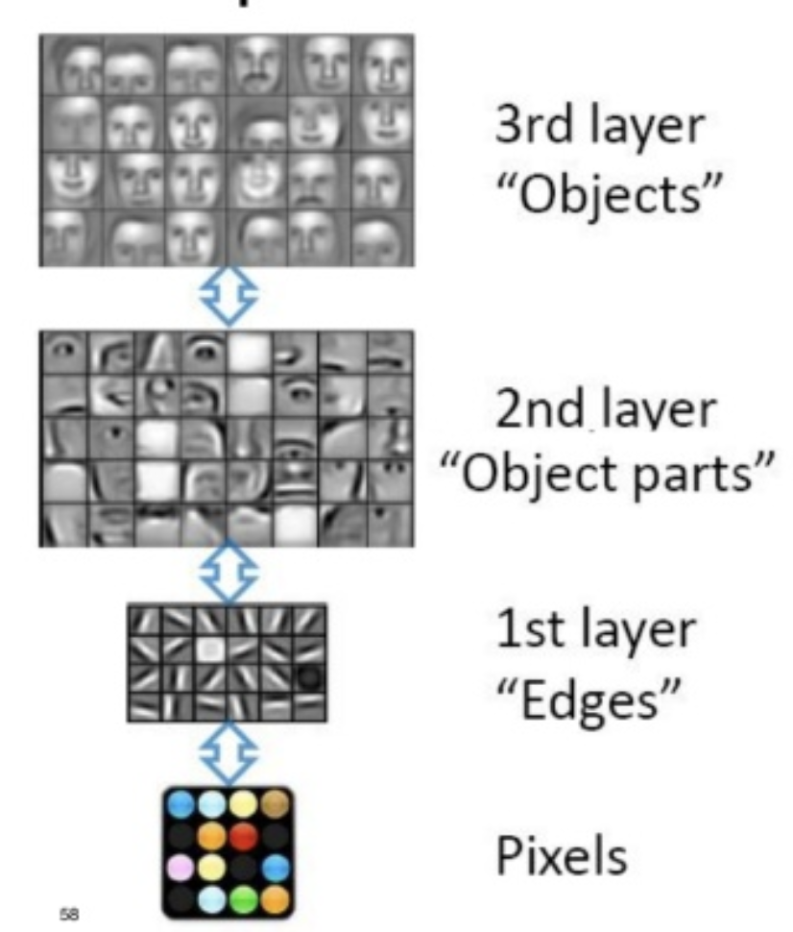
Different Level of abstraction
Source: Deep learning: a bird’s-eye view, by R. Pieters, 2015, pp. 58, 62.

Slide 26
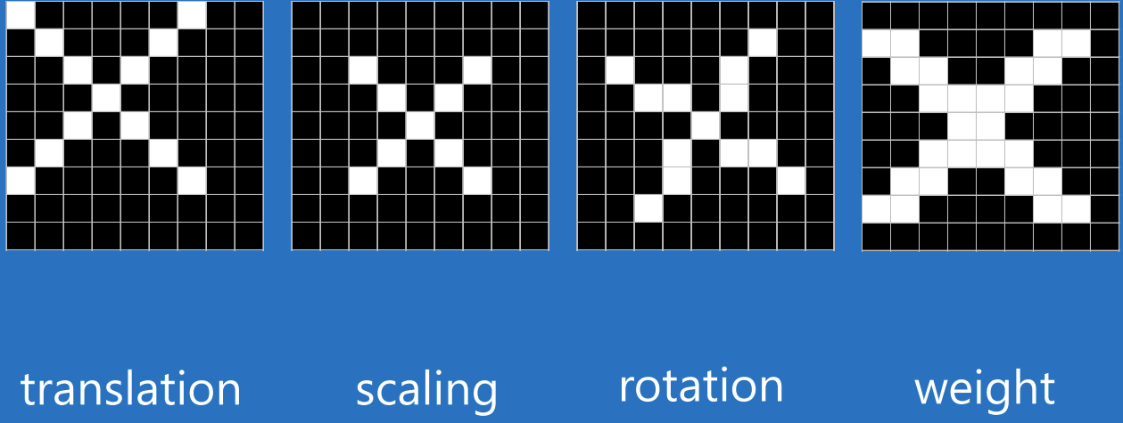
Convolution does not change the image (class of image)
Are they different?

Slide 27
Different types of variations that does not change the images (classes of images)
Translation
Scaling
Rotation
Weight

Slide 28
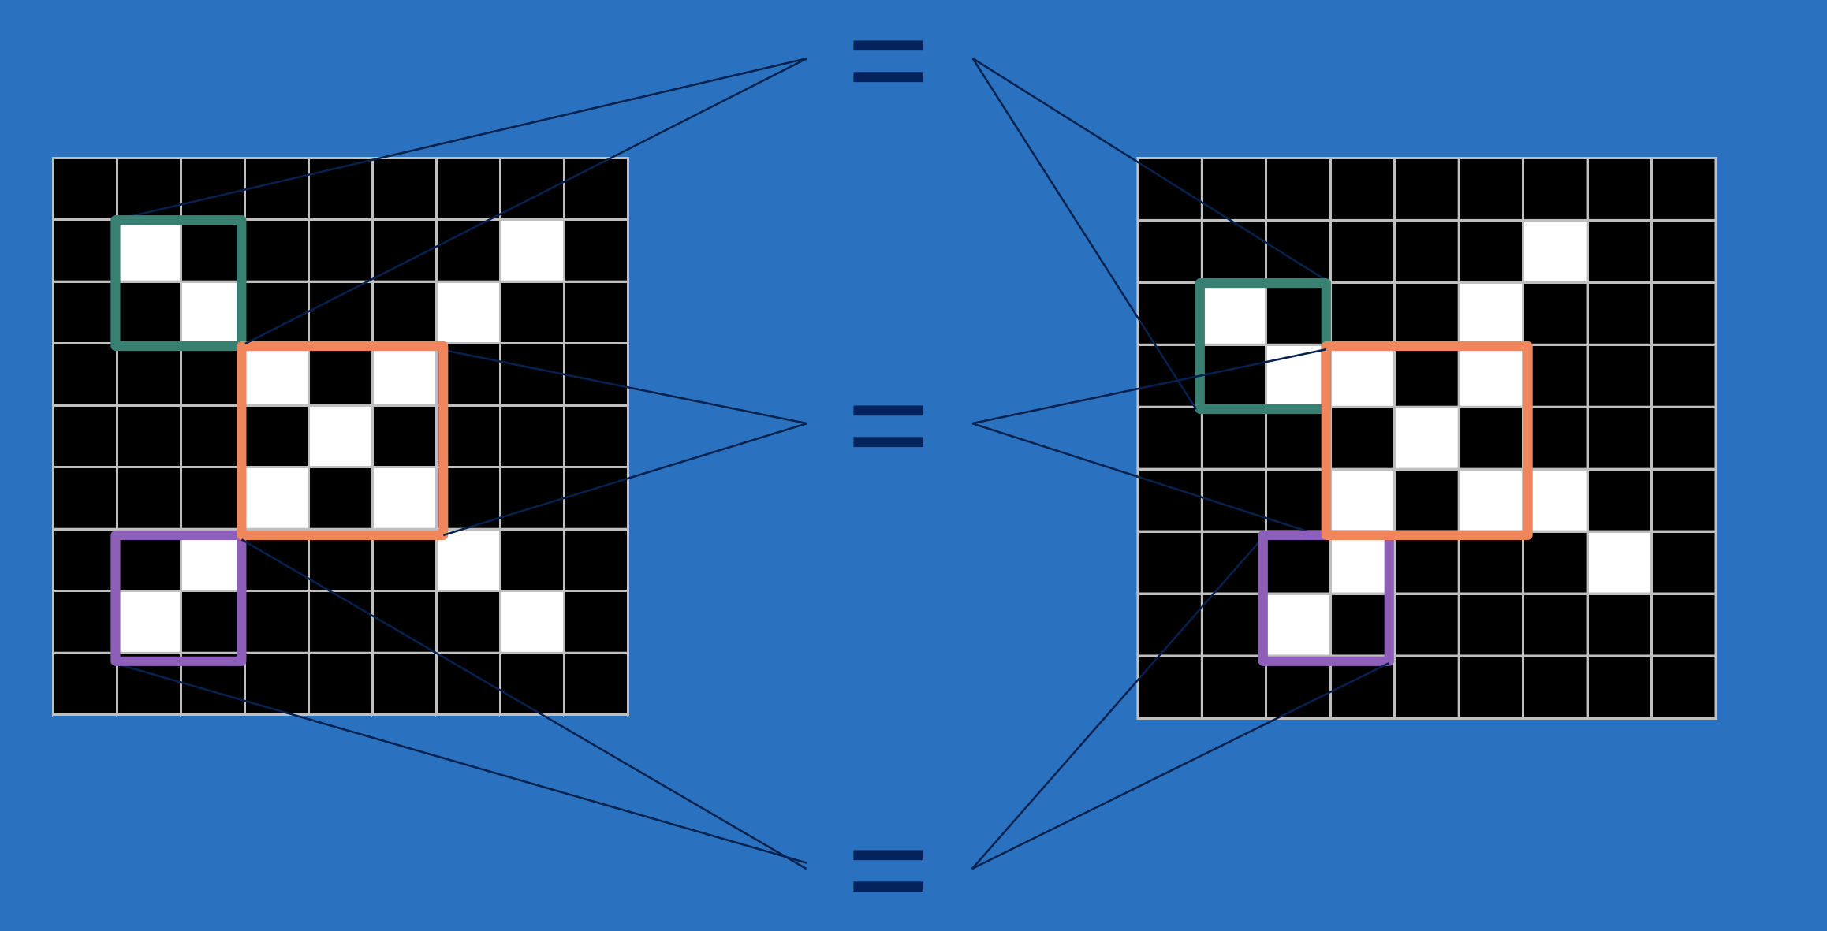
CNNs understand the images are similar by checking their parts
http://brohrer.github.io/

Slide 29
Convolutional Neural Network (CNN)
https://www.saama.com/blog/different-kinds-convolutional-filters/

Slide 30
Convolutional filters for identification of patterns in pieces of the images
Diagonal
Central
Vertical
Horizontal

